Slide 1

Optimizing Retail Performance
BY:
TAPAS RANJAN PATRA
SOUMYA RANJAN PALEI
ANIKET BARIK
CHANDRASHEKHAR NAYAK
SASHIBHUSAN KHATUA

Slide 2
CONTENTS
Introduction
Objectives
Problem Statement
Analysis
Dashboard
Data Overview
Conclusion
Presentation Title

Slide 3

Introduction
The retail industry operates in a highly competitive environment where customer satisfaction and operational efficiency play crucial roles in success. Businesses today generate vast amounts of data, yet many struggle to leverage it effectively to make informed decisions.
By analyzing customer behavior and product trends, we uncover insights to improve sales, optimize inventory, and enhance customer satisfaction.

Slide 4


> Analyze total sales and performance across different regions to pinpoint high-performing and underperforming areas. > Evaluate sales performance by product and category to identify top-sellers and growth opportunities. > Identify customer segments driving sales and craft targeted marketing strategies for each. > Compare sales across regions to detect patterns, such as which regions contribute the most to overall revenue.
Objectives

Slide 5
Problem Statement

Slide 6
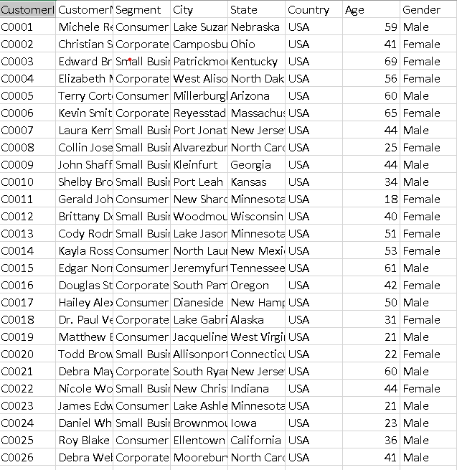
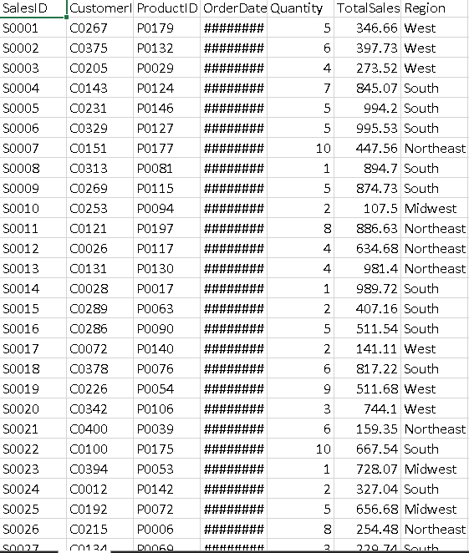
Data Overview

Slide 7
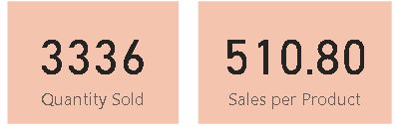
Addition of new measures to dataset
Quantity Sold = SUM(Sales[Quantity])
Sales Per Product = AVERAGE(Sales[Total Sales])

Slide 8
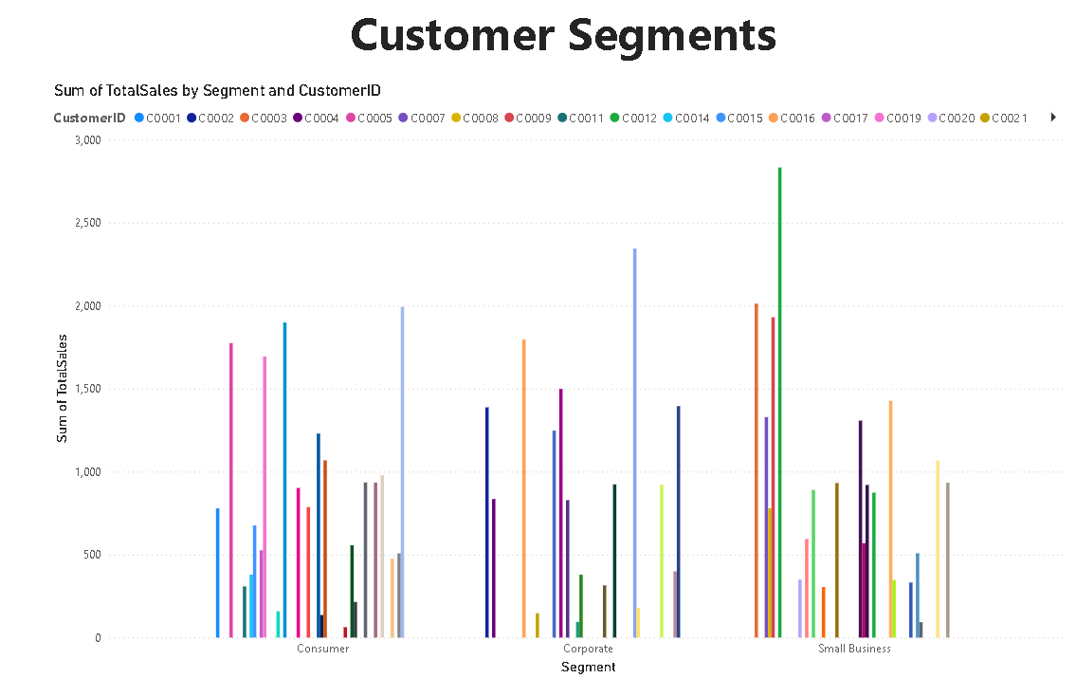
Analysis
Analysis uncovered actionable insights into customer behavior, product trends, and regional sales performance to guide strategic decision-making.
Segmented customers using criteria such as frequency of purchases, spending patterns, and demographics.
Analyzed each segment’s contribution to overall sales.
Top-Performing Segments: Identified the most valuable customer groups based on purchasing behavior.
Targeted Marketing: Create personalized campaigns for high-value segments to enhance customer loyalty.
Product Recommendations: Tailor offerings based on the preferences of different segments to increase cross-selling and upselling.

Slide 9
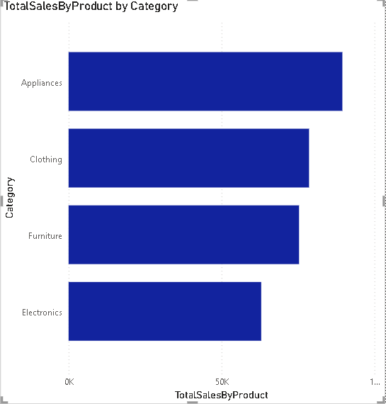
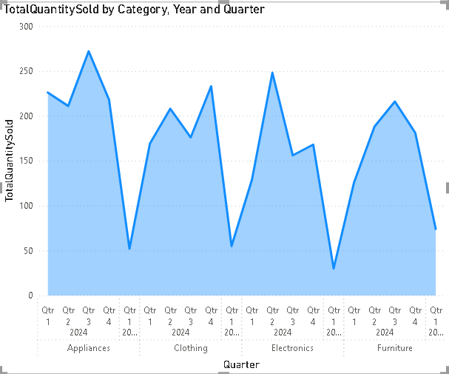
Product Performance Analysis
Analyzed sales data for individual products and categories over a defined period.
Compared performance metrics like total sales, units sold, and revenue generated.
Underperforming Products: Highlighted products or categories with lower sales, signaling the need for strategic changes.
Popular products may benefit from increased stock or targeted promotions to further boost sales.

Slide 10
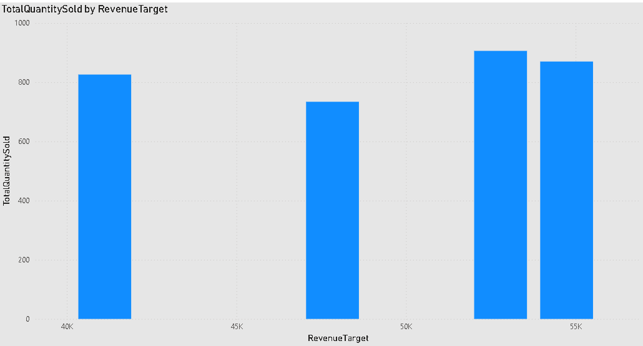
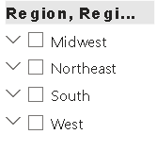
Sales Analysis by Region
Examined sales data region-wise over a specific period.
High-Performing Regions: Highlight regions contributing the most to overall revenue.
Region-Specific Campaigns: Design marketing strategies tailored to the needs of high and low-performing regions.

Slide 11
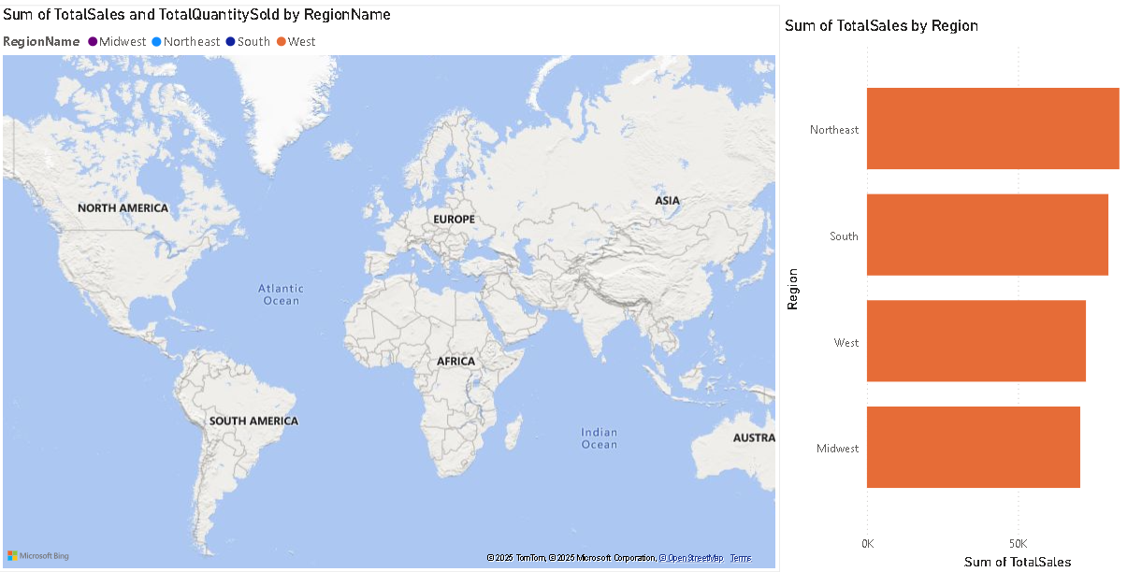
Region-wise Performance Comparison

Slide 12
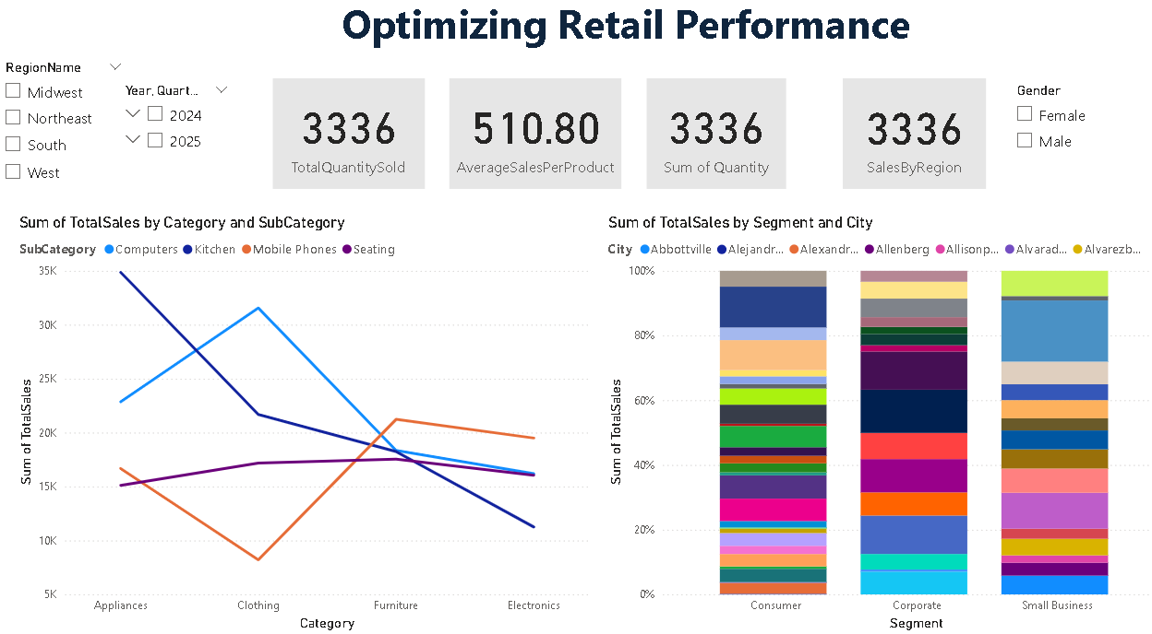
Dashboard

Slide 13
Conclusion
The analysis highlights key insights into customer behavior, product performance, and regional sales trends. By leveraging these findings, businesses can implement targeted strategies to boost sales, optimize inventory, and enhance customer satisfaction. Data-driven decisions will help address challenges, improve efficiency, and drive overall growth.

Slide 14




Thank you

